Slide 2
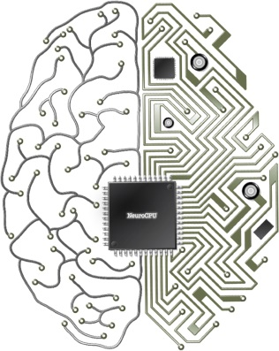
Neural Models: how structures shape dynamics
Vincenzo G. Fiore
School of Behavioral and Brain Sciences, UTD
Neuro CPU lab

Slide 3
Index
There is something about the networks
Input-output and temporal transformation
Feedforward networks: linear dynamics
Recurrent networks: non linear dynamics
Network plasticity
A case study

Slide 4
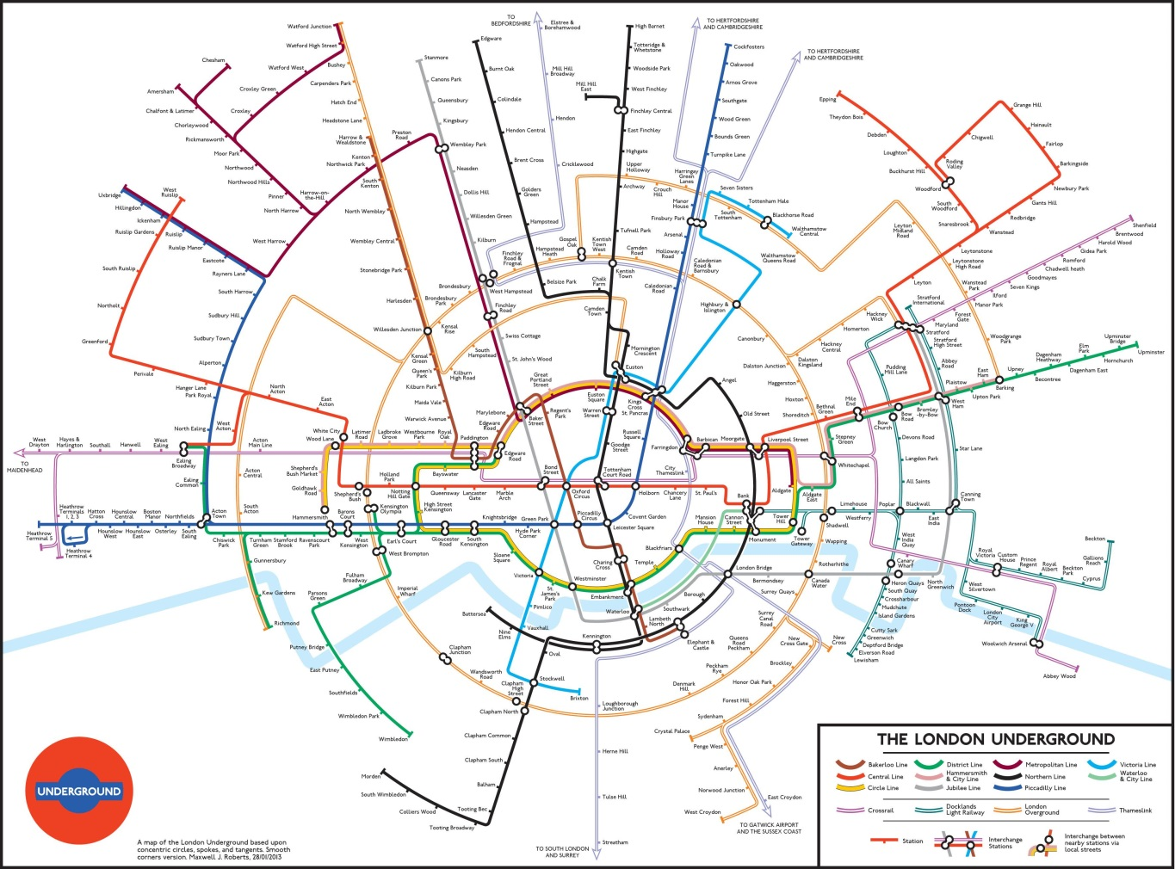
Part I: There is something about the networks
Image by MJ Roberts 2013

Slide 5
Part I: There is something about the networks
Notes:
source: NYTimes, the flight of refugees around the globe
https://www.nytimes.com/interactive/2015/06/21/world/map-flow-desperate-migration-refugee-crisis.html?_r=1

Slide 6
Part I: There is something about the networks
Notes:
MIT Media Lab

Slide 7
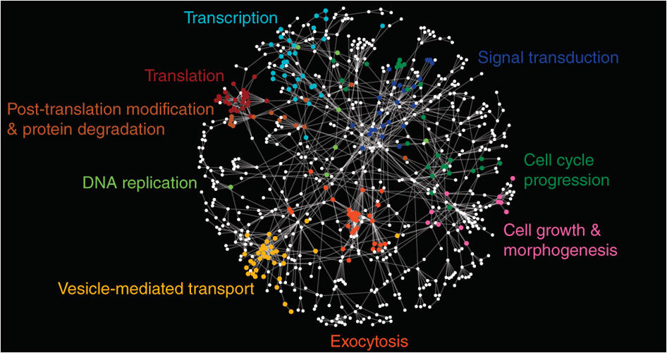
Part I: There is something about the networks
Notes:
http://www.nature.com/nbt/journal/v29/n6/fig_tab/nbt.1855_F1.html
Network diagram of dosage suppression genetic interactions. Genes are represented as nodes and interactions are represented as edges. Colored nodes are sets of genes enriched for Gene Ontology biological processes summarized by the indicated terms. The nodes were distributed using a force-directed layout, such that genes (nodes) that share common dosage suppression interactions form distinct clusters.

Slide 8
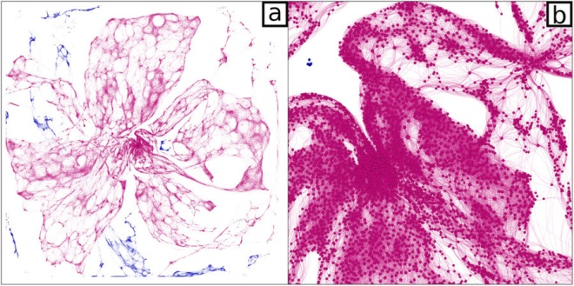
Part I: There is something about the networks
Notes:
https://www.nature.com/articles/s41598-017-00077-z
The network of olive orchard in Puglia. (a) Full view. (b) 10X zoom of the central region. Dots represent olive orchards, while links join all pairs of orchards at a distance of less than 1 km, depicting possible pathways of spread for Xylella fastidiosa. Edges and nodes belonging to the largest connected component (LCC) of the network are colored in magenta, while all other nodes and edges are colored in blue.

Slide 9
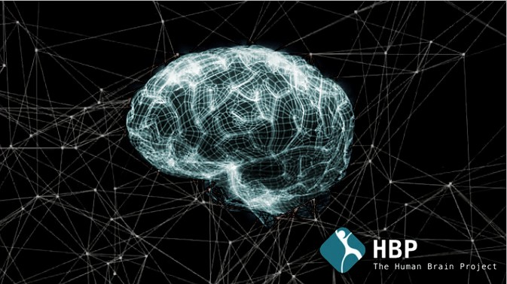
Part I: There is something about the networks
Notes:
Human brain project

Slide 10
The holy grail of diagnosis (and treatment)
Neural activation
?
Behaviour
How can one neural disorder generate multiple (mutually exclusive) symptoms?
How to develop a treatment when the cause is not clear?
Are diagnoses of a psychiatric disorders correct if they are based only on behavioural and neural activation data?

Slide 11
The holy grail of diagnosis (and treatment)
Network
estimation
Neural activation
Behaviour

Slide 12
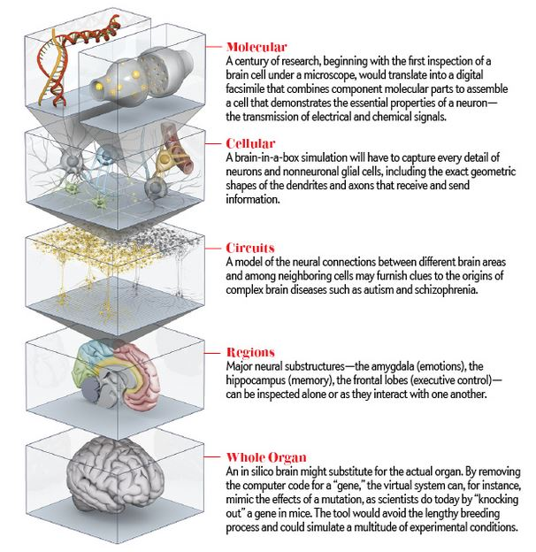
The grain of analysis
What grain of information?
Molecular interaction
Metabolic state of the neurons
Network dynamics (synaptic plasticity etc.)
Distribution of receptors
Neuromodulators involved
Map of neurotransmitters
Micro-connectivity (cluster organization)
Local connectome (macro-connectivity)
Neural region temporal dynamics
Whole brain activity
Image from: https://www.humanbrainproject.eu

Slide 13
Functional Connectivity
This statistical correlation analysis quantifies dependencies among neurophysiological events, describing statistically significant patterns of temporal correlations.
In this example, images show connectivity loss in the Default Mode Network in early Alzheimer’s disease (B) in comparison with cognitively normal elderly.
Images identify statistically significant regional differences in functional connectivity of the precuneus between populations.
Image from: Sheline & Raichle 2013. Resting State Functional Connectivity in Preclinical Alzheimer’s Disease:
A Review. Biol Psychiatry. 74:5
Notes:
Figure 3A and 3B: Resting state functional connectivity is significantly decreased in early Alzheimers disease. Using the precuneus as the seed region there is less functional connectivity with the left hippocampus (L Hip), left parahippocampus (L Parahip), anterior cingulate cortex (AC) and gyrus rectus (GR) and increased connectivity with visual cortex (VC). Figure 3C and 3D: Again using the precuneus as the seed region, the same pattern of rs-fMRI abnormalities was found in cognitively normal persons with elevated amyloid binding on PIB-PET. The regions with decreased functional connectivity are shown in blue and those with increased connectivity are shown in red. Adapted from Sheline et al (68). Resting state fMRI functional connectivity (rs-fMRI) analysis is increasingly used to detect subtle brain network abnormalities in illnesses such as Alzheimer’s disease (AD). An important question has been whether the effects of fibrillar amyloid-beta could be detected in brain functional studies as well as in molecular imaging studies prior to the development of cognitive change. Several studies using resting state functional MRI(68–70), have supplied supporting evidence, demonstrating, that as in AD and MCI there is significantly decreased default mode network (DMN) connectivity in cognitively normal elderly with elevated brain amyloid. Shown in Figure 3, in early Alzheimers disease (clinical dementia rating scale, CDR = 0.5) resting state functional connectivity of the precuneus (part of DMN) was significantly decreased with the left hippocampus, anterior cingulate cortex and gyrus rectus and increased with visual cortex (Figures 3a and 3b). The same pattern of rs-fMRI abnormalities was found in cognitively normal persons with elevated amyloid (Figures 3c and 3d), supporting the concept that amyloid deposition results in changes in rs-fMRI functional connectivity prior to any clinical symptoms.
https://www.ncbi.nlm.nih.gov/pmc/articles/PMC2829379/

Slide 14
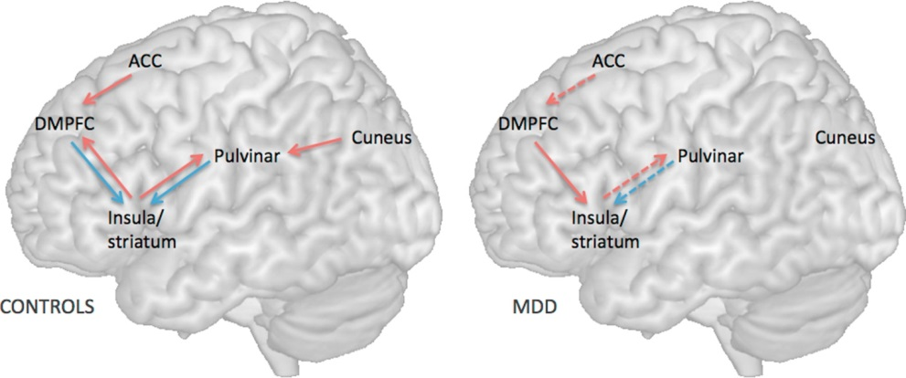
Effective Connectivity
This method estimates the directed causal influence that neural systems exert on one another. The aim is to describe the simplest possible circuit capable to replicate the target data. This is achieved via model comparison, testing hypotheses concerning directed causal influence.
In this example, the schematic encompass all the tested alternative models. The “winning model” represents the best fit for the target data in controls (left) and patients (right) with major depressive disorder (MDD).
Note the presence of constraints, directionality and connectivity value.
1
2
4
5
3
Image from: Iwabuchi et al. 2014. Alterations in effective connectivity anchored on the insula in major depressive disorder. European Neuropsychopharmacology. 24:11
Notes:
Figure 1. Simplified schematic of effective connectivity in controls and patients with MDD. Solid red lines indicate significant positive connectivity, solid blue lines represent significant negative connectivity, and dashed lines indicate significantly reduced connectivity in patients compared to controls. Missing arrows in MDD signify no significant connectivity in either direction.
In 16 patients with current MDD, and 16 healthy controls, we investigated differences in directional influences between anterior insula and the rest of the brain using resting-state functional magnetic resonance imaging (fMRI) and Granger-causal analysis (GCA), using anterior insula as a seed region. Results showed a failure of reciprocal influence between insula and higher frontal regions (dorsomedial prefrontal cortex) in addition to a weakening of influences from sensory regions (pulvinar and visual cortex) to the insula. This suggests dysfunction of both sensory and putative self-processing regulatory loops centered around the insula in MDD. For the first time, we demonstrate a network-level processing defect extending from sensory to frontal regions through insula in depression. Within limitations of inferences drawn from GCA of resting fMRI, we offer a novel framework to advance targeted network modulation approaches to treat depression.
http://www.sciencedirect.com/science/article/pii/S0924977X14002363

Slide 15
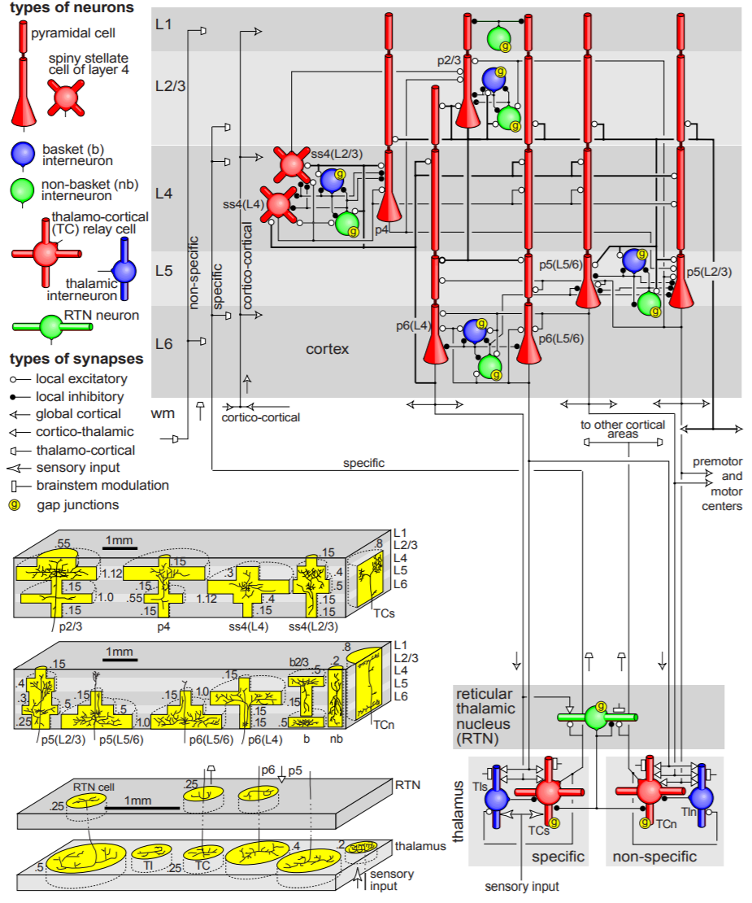
Structural Connectivity
This connectionist method replicates in silico the anatomical features of a target neural structure: computational processes of neurons in the network and their connectivity. These simulated neural circuits are used to estimate or predict neural dynamics and associated general computational processes under different conditions of manipulation or putative disorder.
Examples vary significantly from highly detailed simulations of the computational processes performed by a single neuron, to networks encompassing millions of simplified neurons.
Image from: Izhikevich & Edelman 2008 Large-scale model of mammalian thalamocortical systems. PNAS 105(9)
Notes:
Simplified diagram of the microcircuitry of the cortical laminar structure (Upper) and thalamic nuclei (Lower). Neuronal and synaptic types are as indicated. Only major pathways are shows in the figure.
quote by the authors: “On October 27, 2005 I finished simulation of a model that has the size of the human brain. The model has 100,000,000,000 neurons (hundred billion or 10^11) and almost 1,000,000,000,000,000 (one quadrillion or 10^15) synapses. It represents 300x300 mm^2 of mammalian thalamo-cortical surface, specific, non-specific, and reticular thalamic nuclei, and spiking neurons with firing properties corresponding to those recorded in the mammalian brain. (Even if the model had only 1000 neurons, it would still be one of the most detailed models ever simulated.)
The model exhibited alpha and gamma rhythms, moving clusters of neurons in up- and down-states, and other interesting phenomena (watch a 25M .avi or .mov movie).
One second of simulation took 50 days on a beowulf cluster of 27 processors (3GHz each).”
https://www.izhikevich.org/publications/large-scale_model_of_human_brain.pdf

Slide 16
Part II: input-output and temporal transformation
Image: J O Heron

Slide 17
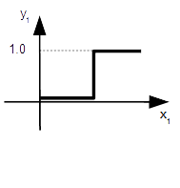
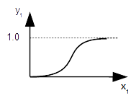
Input-output transformation
$$y_{1}=0$$
$$y_{1}=1$$
$$0$$
$$x_{1}$$
Numeric
input
Numeric
output
$$x_{1}$$
$$⨍(x)$$
$$y_{1}$$
Computational
process
$$y_{1}=0$$
0<$y_{1}<1$
$$y_{1}=1$$
$$0$$
$$x_{1}$$

Slide 18
Input-output transformation
$$x_{1}$$
$$⨍(x)$$
$$y_{1}$$
VIDEO 1
Time
Time
Single input (heat map, left), transformed in multiple outputs (right):
single spiking neuron
cluster of spiking neurons
mean field
Notes:
video 1
one dimensional input, linear transformation,
single spiking neuron,
cluster of spiking neurons
mean field

Slide 19
Input-output transformation

Slide 20
Input-output transformation
Dimensionality reduction and information compression
$$x_{2}$$
$$x_{1}$$
Numeric
output
$$y_{1}=0$$
0<$y_{1}<1$
$$y_{1}=1$$
Numeric
inputs
$$⨍(x)$$
$$y_{1}$$
$$x_{2}$$
Computational
process
$$y_{1}=0$$
0<$y_{1}<1$
0<$y_{1}<1$
$$y_{1}=0$$
$$y_{1}=0$$
$$y_{1}=0$$
$$x_{1}$$
$$Σx_{i}Σ$$

Slide 21
Input-output transformation
$$x_{1}$$
$$⨍(x)$$
$$y_{1}$$
$$x_{2}$$
VIDEO 2
Heat maps of the input-output connectivity (left), multiple inputs (centre), and multiple outputs (centre), mean field activity.

Slide 22
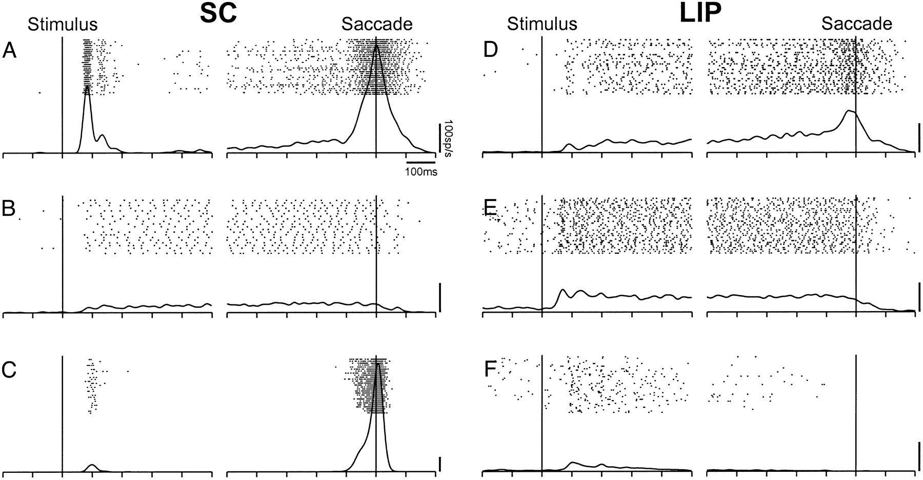
Temporal transformation
Non linear dynamics: looking beyond feed-forward networks
Discharge properties recorded in neurons of lateral intraparietal area (LIP) and superior colliculus (SC) in monkeys, during a delayed saccade task in which the presentation of the visual stimulus was sustained from its onset to the end of the trial (visual trials).
The neurons in the SC intermediate layers show independence from sustained visual stimulation. In particular, onset neural response is not correlated with motor movements and does not linearly result from the presence of the stimulus.
Image from: Paré & Wurtz 2001. Progression in Neuronal Processing for Saccadic Eye Movements From Parietal Cortex Area LIP to Superior Colliculus. Journal of Neurophysiology. 85:6
Notes:
Onset detector as an example of non-linear transformation Examples of an (A) LIP output neuron, (B) FEF output neuron, and (C) SC neuron, showing activity in the visual delayed saccade task. Rasters and spike density functions show the activity aligned to the onset of the visual stimulus, at left, or to the saccade initiation, at right. The three periods of neuronal activity are indicated qualitatively: the visual, the delay, and the presaccadic (examples in A and C are from Pare´ and Wurtz (2001)).
Examples of 3 SC (A–C) and 3 LIP (D–F) neurons illustrating the range of activity patterns observed in the delayed saccade task, in which the visual stimulus remained on from its onset to the end of the trial (visual trials).
Neurons in both the lateral intraparietal area (LIP) of the monkey parietal cortex and the intermediate layers of the superior colliculus (SC) are activated well in advance of the initiation of saccadic eye movements. To determine whether there is a progression in the covert processing for saccades from area LIP to SC, we systematically compared the discharge properties of LIP output neurons identified by antidromic activation with those of SC neurons collected from the same monkeys. First, we compared activity patterns during a delayed saccade task and found that LIP and SC neurons showed an extensive overlap in their responses to visual stimuli and in their sustained activity during the delay period. The saccade activity of LIP neurons was, however, remarkably weaker than that of SC neurons and never occurred without any preceding delay activity. Second, we assessed the dependence of LIP and SC activity on the presence of a visual stimulus by contrasting their activity in delayed saccade trials in which the presentation of the visual stimulus was either sustained (visual trials) or brief (memory trials). Both the delay and the presaccadic activity levels of the LIP neuronal sample significantly depended on the sustained presence of the visual stimulus, whereas those of the SC neuronal sample did not. Third, we examined how the LIP and SC delay activity relates to the future production of a saccade using a delayed GO/NOGO saccade task, in which a change in color of the fixation stimulus instructed the monkey either to make a saccade to a peripheral visual stimulus or to withhold its response and maintain fixation. The average delay activity of both LIP and SC neuronal samples significantly increased by the advance instruction to make a saccade, but LIP neurons were significantly less dependent on the response instruction than SC neurons, and only a minority of LIP neurons was significantly modulated. Thus despite some overlap in their discharge properties, the neurons in the SC intermediate layers showed a greater independence from sustained visual stimulation and a tighter relationship to the production of an impending saccade than the LIP neurons supplying inputs to the SC. Rather than representing the transmission of one processing stage in parietal cortex area LIP to a subsequent processing stage in SC, the differences in neuronal activity that we observed suggest instead a progressive evolution in the neuronal processing for saccades.

Slide 23
Temporal transformation
Non linear dynamics are the key feature of recurrent neural network. The presence of connections directed laterally or backwards (towards input units in the network) allows the system to exhibit dynamic temporal changes. Examples are: onset and offset detectors or internal memory.
$$x_{1}$$
$$⨍(x)$$
$$y_{1}$$
$$x_{1}$$
$$⨍(x)$$
$$y_{1}$$
$$⨍(x)$$
Self connection (memory)
Lateral connection (Onset)
Notes:
add text “lateral connection” and “self connection”

Slide 24
Temporal transformation (onset and memory)
$$x_{1}$$
$$⨍(x)$$
$$y_{1}$$
$$⨍(x)$$
VIDEO 3
Heat maps of the lateral connectivity in the output structure (left), multiple inputs (centre), and multiple outputs (centre), mean field activity. Eye matrix used for input-ouput connectivity.
- Memory and onset function
Notes:
video 3
two inputs, non-linear temporal transformations
onset detector
memory

Slide 25
Attractors
Attractor states: point attractors and pattern generators
Due to recurrent connectivity, neural networks can exhibit nonlinear associations between inputs and patterns of activity. State transitions can lead towards stable (e.g. point attractors) or dynamic patterns (e.g. oscillators or chaotic attractors).
In presence of attractor states, different inputs converge towards the same network configuration (or pattern) of activity. The stronger the attractor, the more the network is able to resist perturbations, ignoring noise in the input and less relevant competing signals.

Slide 26
Temporal transformation (attractors)
VIDEO 4
Heat maps of the lateral connectivity in the output structure (left), multiple inputs (centre), and multiple outputs (centre), mean field activity. Eye matrix used for input-ouput connectivity.
- Point attractors and pattern generator
Notes:
video 4
two inputs, non-linear temporal transformations
point attractors
linear attractor
video 5
two inputs, non-linear temporal transformations
oscillators
chaotic attractors

Slide 27
Network plasticity
The structure of a neural circuit changes over time. The duration of these alterations varies significantly: from years, as those induced by synaptic plasticity (long term potentiation or depression, due to learning processes), to a fraction of a second, as those caused by the phasic or tonic presence of neuromodulators.
By changing connection weights dynamically, these processes effectively mould the energy landscapes describing the temporal transitions of the networks.

Slide 28
Network plasticity
Phasic and tonic modulation.
Neuromodulators such as dopamine, noradrenaline and serotonin regulate electrical and biochemical neural functions, affecting in particular excitability of target units, synaptic transmission and plasticity, protein trafficking and gene transcription.
Fluctuation of neuromodulator release can potentiate or suppress (depending on the receptors involved) signal transmission among neural populations, altering temporal transitions and general stability of the circuit.
Image from: Hauser et al. 2016 Computational Psychiatry of ADHD: Neural Gain Impairments across Marrian
Levels of Analysis. Trends Neurosci 39(2)
Notes:
Dopaminergic Modulation of Synaptic Transmission in Cortex and Striatum

Slide 29
Network plasticity (effective connectivity)
VIDEO 5
Heat maps of the lateral connectivity in the output structure (left), multiple inputs (centre), and multiple outputs (centre), mean field activity. Eye matrix used for input-ouput connectivity.
- transition from hyper-stable into meta-stable dynamics, as a function of dopamine fluctuations
Notes:
video 7
two inputs, non-linear temporal transformations
Gain alterations associated with neuromodulator release fluctuations.
metastability vs multistability

Slide 30
Input-output and temporal transformation
Linear transformation
Non-linear dynamics (onset, memory etc.)
Attractor states (point attractors, linear attractors
Changes in effective connectivity and network dynamics
How is this useful?
Notes:
video 7
two inputs, non-linear temporal transformations
Gain alterations associated with neuromodulator release fluctuations.
metastability vs multistability

Slide 31
Part III: circuit gain and stability as a case study

Slide 32
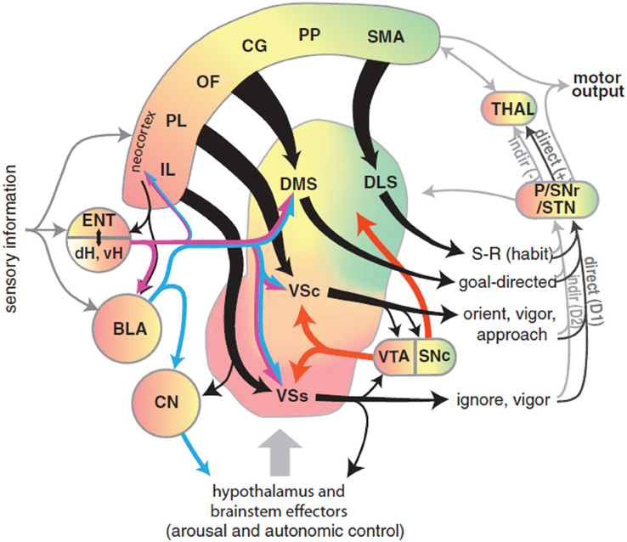
Multidimensional integration
Dimensionality reduction
inputs from multiple sources converge in the striatum, which integrates incoming information.
Information compression
information encoded in the striatum is propagated towards the internal nuclei of the Basal Ganglia. The numerosity of neurons diminishes at each step, (also) leading to noise cancelling and partial loss of information.
Image from: Gruber & McDonald 2012. Context, emotion, and the strategic pursuit of goals: interactions among multiple brain systems controlling motivated behavior. Front Behav Neurosci 6:50

Slide 33
Signal encoding in the Basal Ganglia
VIDEO 6

Slide 34
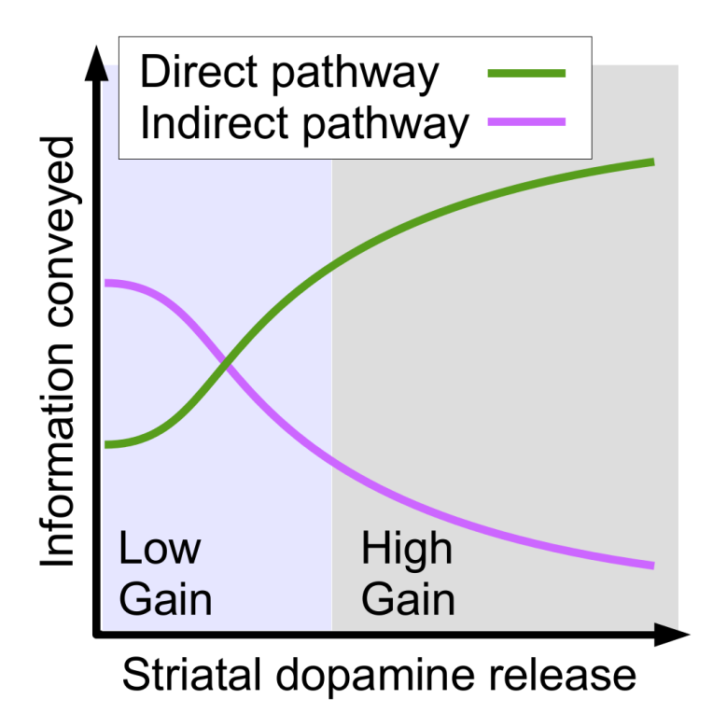
Gain control and psychiatric disorders
Anatomical connectome of the cortico-thalamo-striatal cirtuit.
Effective connectivity in the cortico-thalamo-striatal circuit.
Changes in effective connectivity affect the stability of the circuit.

Slide 35
Gain control and psychiatric disorders
Meta-stable dynamics: multiple shallow attractors.
Stable conditions: multiple point attractors, sensory driven transient stability.
Hyper stable dynamics: parasitic attractor.

Slide 36
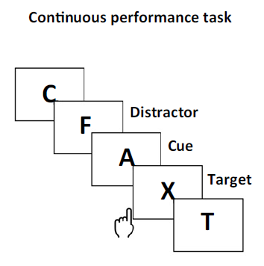
Gain control and psychiatric disorders
Replicating target data as a mean for the validation of the model.
Models are characterised by a vast number of free parameters. by By replicating either behavioural or neural activity data we can find new constraints to limit the space of parameters or validate the model.
In this example, we used data recorded in ADHD patients tasked with the continuous performance task. Participants see a sequence of random letters and have to respond when the letter combination ‘A’-‘X’ appears in
sequence.
Image from: Hauser et al. 2016 Computational Psychiatry of ADHD: Neural Gain Impairments across Marrian
Levels of Analysis. Trends Neurosci 39(2)
Notes:
Figure I. [4TD$DIF]Neural GainandCatecholamines. (A) Neural gain has an amplifyingeffectonneuronalsignalsbyboosting strong inputs.(B)Catecholaminesystemsarecrucialformodulatingbrain-wideneuralgain.Onanetwork-level,(C)high gain leadstostableattractorstatesandthusconsistentoutputsandbehaviours,whereas(D)lowgaincausesunstable and shallowattractorstates.

Slide 37
Gain control and psychiatric disorders
VIDEO 7
Notes:
Figure I. [4TD$DIF]Neural GainandCatecholamines. (A) Neural gain has an amplifyingeffectonneuronalsignalsbyboosting strong inputs.(B)Catecholaminesystemsarecrucialformodulatingbrain-wideneuralgain.Onanetwork-level,(C)high gain leadstostableattractorstatesandthusconsistentoutputsandbehaviours,whereas(D)lowgaincausesunstable and shallowattractorstates.

Slide 38
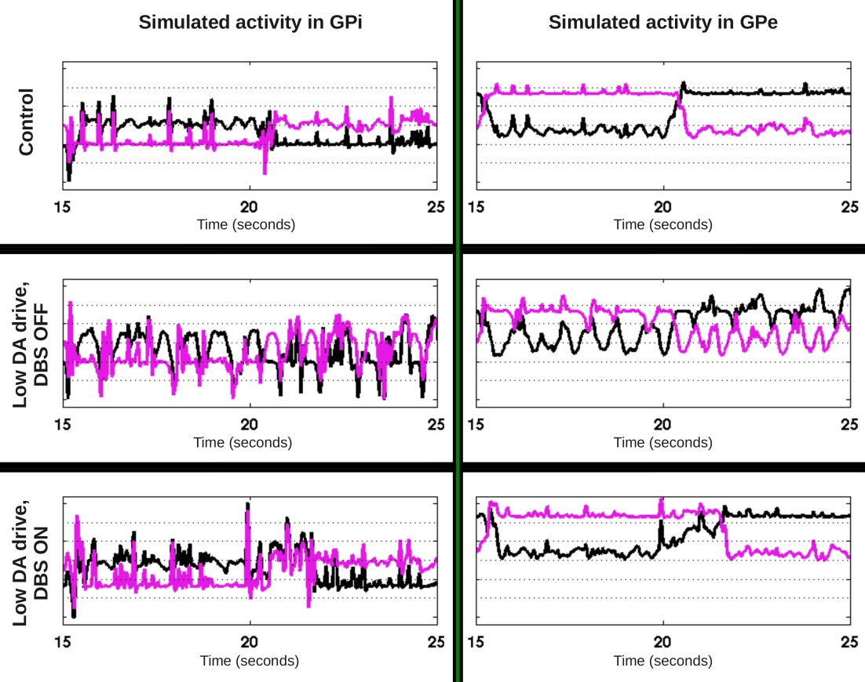
Temporal transformation
Attractor states: pattern generators
Independently of the stability of the input, the neural activity of a recurrent neural circuit may result in ordered sequences (or patterns) of activations. These patterns have been described and recorded in the spinal cord, and they are considered to be responsible for the timing of contraversive movements.
Several models have also pointed out that sequences of activations can also be implemented in the basal ganglia, resulting in several motor and psychiatric disorders.
Image from: Fiore et al. 2016 Changing pattern in the basal ganglia: motor switching under reduced dopaminergic drive. Sci. Rep. 6(23327)
Notes:
A, Model 1. B, Model 2. Neural populations are shown by spheres. Excitatory and inhibitory synaptic connections are represented by arrows and circles, respectively. The RG in each side of the cord includes RG-F and RG-E interacting via the inhibitory Inrg-F and Inrg-E populations. Suffix F- or E- in the population names indicate that the population is co-active with the flexor or extensor RG centre, respectively. The left and right RGs interact via CINs: CINe-F (V3), CINi-F (V0_{D}) and CINe1-F (V0_{V}) in Model 1 (A), and CINe-F (V3), CINi-F (V0_{D}) and CINe-E (V0_{V}) in Model 2 (B). CIN, commissural interneuron; -E, extensor; -F, flexor; l-, left; r-, right; RG, rhythm generator.
https://www.ncbi.nlm.nih.gov/pmc/articles/PMC4461406/

Slide 39
Signal encoding and circuit gain
Cyclic sequences of selections. Internal state driven pattern generation.
Noise-driven flexibility. Meta-stable dynamics.
?
GP effective connectivity
Suppression of activity. Internal state driven stable dynamics.
Sensory driven flexibility. Multistable dynamics.
Aberrant activity. Hyper-stable dynamics.
Striatal DA release

Slide 40
Thanks to the organisers:
Xiaosi Gu and Rick Adams
ADHD formulation:
Ray Dolan
Tobias Hauser
Michael Moutoussis
Computational Psychiatric Unit in UTD
Xiaosi Gu
Ryan Philps
Ju-Chi Yu
Soojung Na

Slide 41
Neural Models: how structures shape dynamics Thank you!

